Slide 1
Oxalic Acid
in
Varroa Management
Randy Oliver
2015
(see notes under the slides)

Slide 2
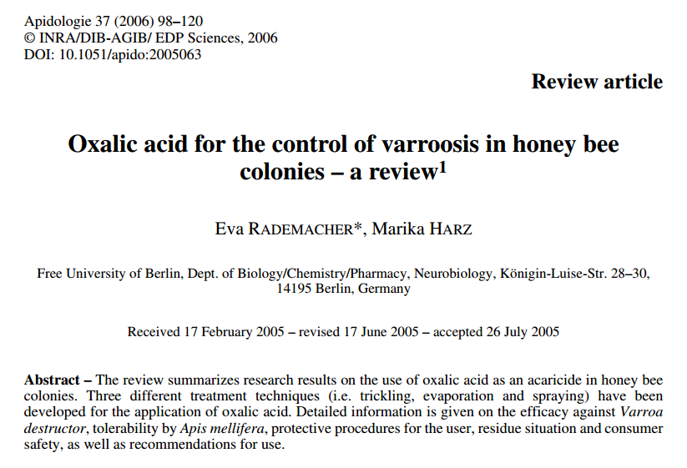
Oxalic has a long history in Europe

Slide 3
Why Oxalic Acid?

Slide 4
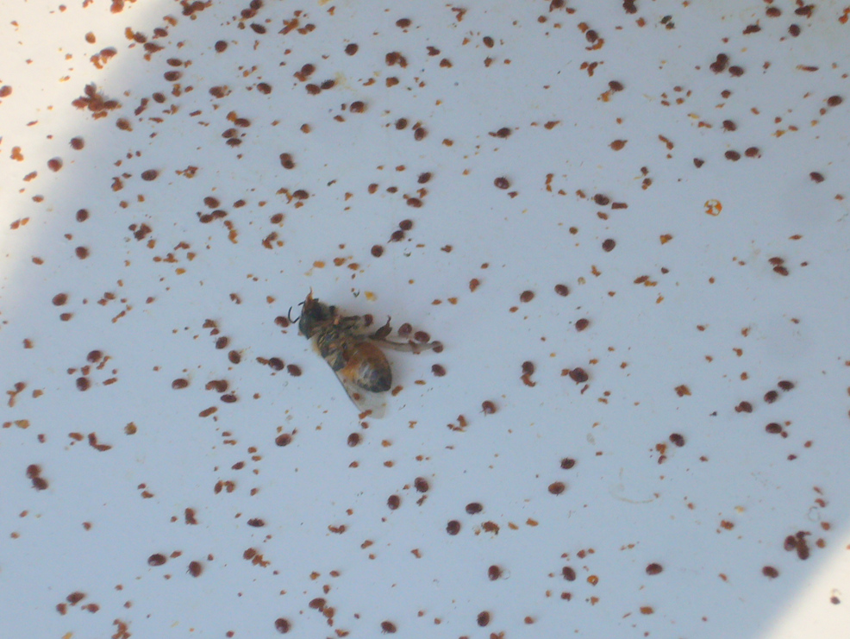
Acids are much more
toxic to mites than to bees

Slide 5
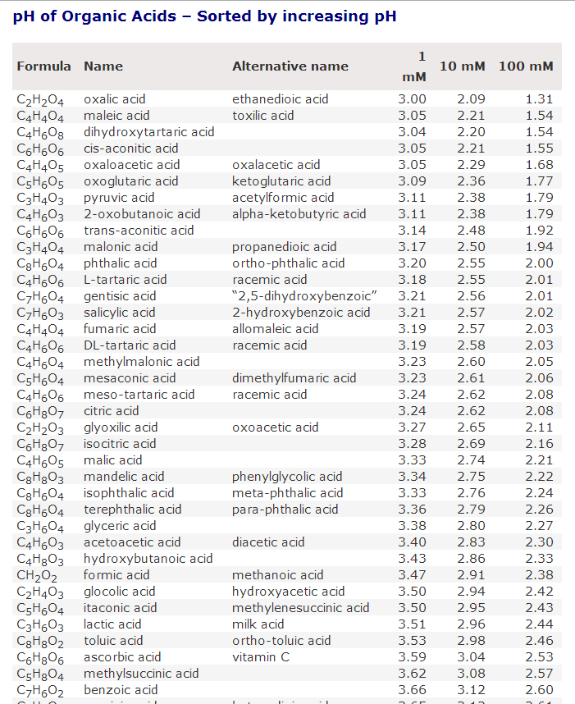
Oxalic is the strongest organic acid
Notes:
Oxalic has a high dissociation constant, meaning that it has more acidic effect than citric, acetic, or lactic acid—any of which can be used for varroa control. Oxalic just works best.

Slide 6
Safety to Humans

Slide 7
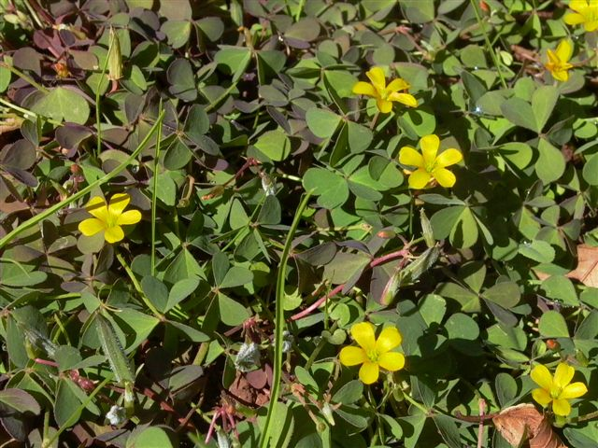
Oxalis
Notes:
This is a photo of one of the oxalis species. Most Californians remember enjoying sucking on the stems of Buttercup Oxalis as kids. The juice tastes similar to lemonade, and is essentially the same as the oxalic syrup that we apply to our hives.

Slide 8
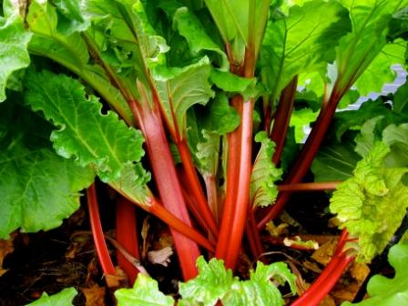
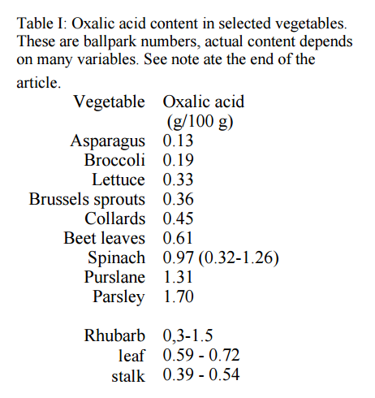
http://helios.hampshire.edu/~nlNS/mompdfs/oxalicacid.pdf

Slide 9

Typical treatment=
1 serving
per hive
Notes:
That’s for a single serving—not the whole can.

Slide 10
Purchasing Oxalic Acid

Slide 11
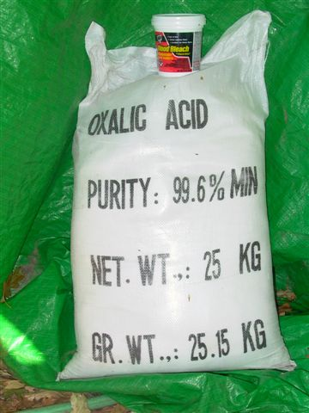
Sold as
oxalic acid dihydrate
“Wood Bleach”

Slide 12
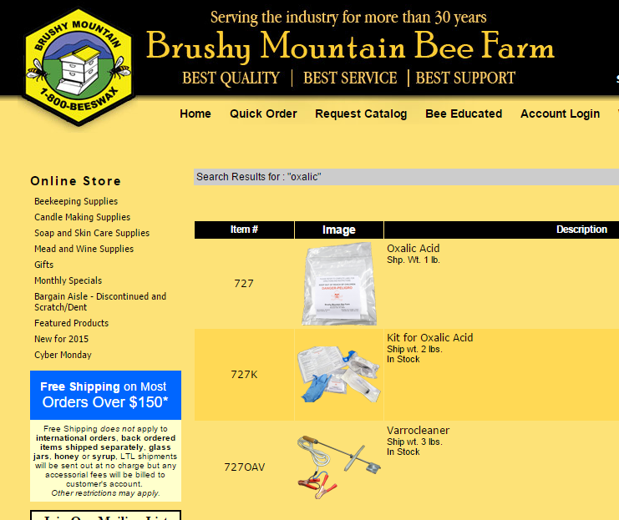
Thanks to Brushy Mountain for registering oxalic!

Slide 13
Mixing Oxalic Syrup

Slide 14
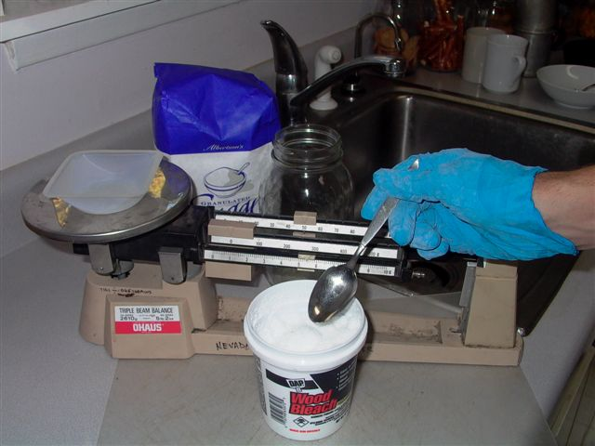

Need to weigh
Notes:
I’ve tested to see whether it is accurate to measure oxalic crystals by the teaspoon—IT IS NOT! You can buy an accurate digital scale for less than $10. Thin gloves remind you not to rub your eyes—you DO NOT want to get a crystal into your eye! The crystals don’t burn dry skin, and can be easily washed off with water.

Slide 15

Don’t use hard water
Notes:
Hard water (containing calcium or magnesium) will cause the oxalic acid to precipitate out as an oxalate. If you see a white powder settle to the bottom when you dissolve oxalic into water, then use softened, distilled, or deionized water instead.

Slide 16
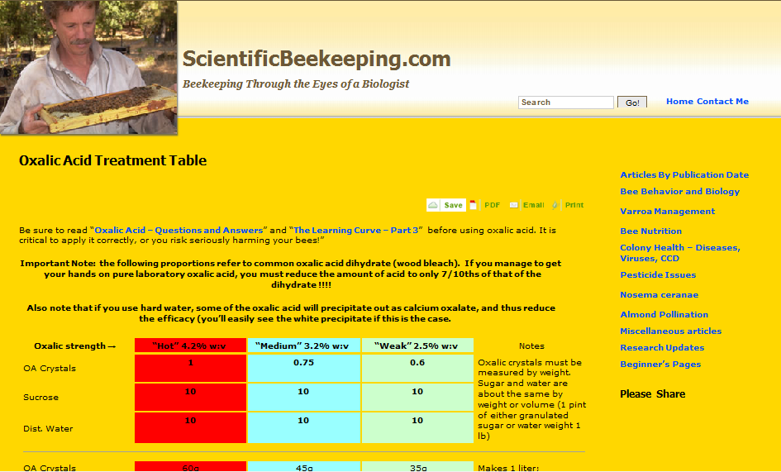
Use the exact dose!
Notes:
There is little margin for error with oxalic. Accidentally doubling the dose will hurt your bees.

Slide 17
Oxalic strength→ | “Hot” 4.2% w:v | “Medium” 3.2% w:v | “Weak” 2.5% w:v | Notes
OA crystals | 1 | 0.75 | 0.6 | Oxalic crystals must be measured by weight. Sugar and water are about the same by weight or volume (1 pint of either granulated sugar or water weigh 1 lb)
Sucrose | 10 | 10 | 10
Dist. Water | 10 | 10 | 10
OA crystals | 60g | 45g | 35g
Sucrose | 600g | 600g | 600g | Makes 1 liter Treats about 20 colonies
Dist. water | 600ml | 600ml | 600ml
OA crystals | 100g | 75g | 60g
Sucrose | 1 kg | 1 kg | 1 kg | Makes 1700ml Treats about 33 colonies
Dist. water | 1 liter | 1 liter | 1 liter
OA crystals | 232g | 174g | 139g
Sucrose | 5 lb | 5 lb | 5 lb | Makes 1+ gallon Treats about 75 colonies
Dist. water | 2.5 qt | 2.5 qt | 2.5 qt
OA crystals | 1112g (2lb 7oz) | 834g (1lb 13.4oz) | 667g (1lb 7.5oz)
Sucrose | 25 lb | 25 lb | 25 lb | Makes 5 gallons Treats about 375 colonies
Dist. water | 3 gal | 3 gal | 3 gal
Notes:
Here’s a close up of the table. The full table is available at http://scientificbeekeeping.com/oxalic-acid-treatment-table/
Simply Google “oxalic acid treatment table”

Slide 18
Oxalic acid crystals dissolve more readily in hot water than in sugar solution.
Tip: dissolve the oxalic crystals in the indicated amount of hot (150˚F) water before adding the sugar.
After the oxalic crystals are fully dissolved, only then stir in the sugar.

Slide 19
Storage

Slide 20
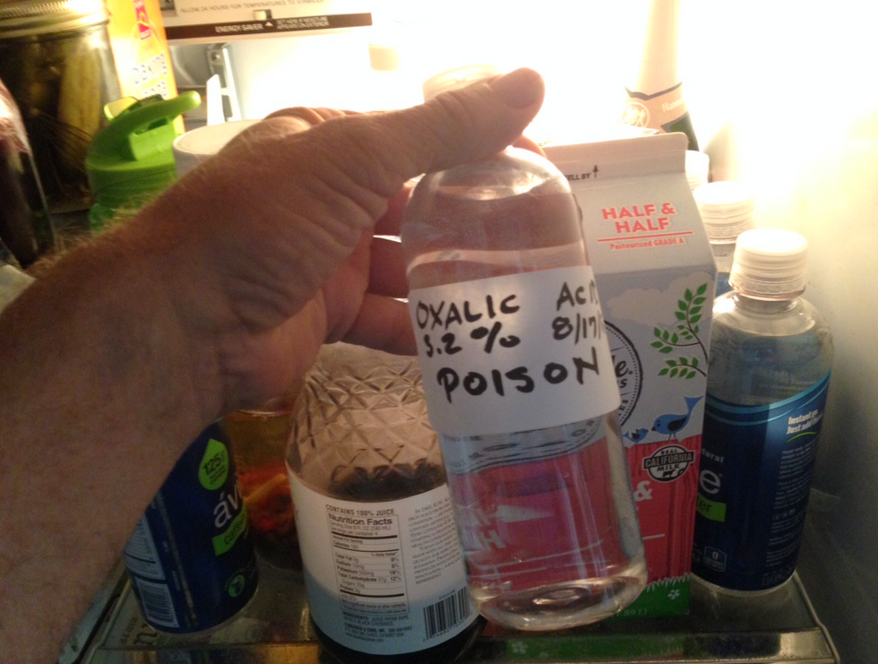
Store in the ‘fridge
Notes:
Do not store in the ‘fridge if you have small children. The mixture tastes like lemonade. Always label the syrup as poison. It will keep for several months. Under warm storage, the acid causes a chemical reaction that turns the sugar into bee-toxic HMF. I’m not sure whether it creates enough HMF to harm the bees when dribbled, but no need to find out. Discard the solution if it discolors.

Slide 21
Safety

Slide 22
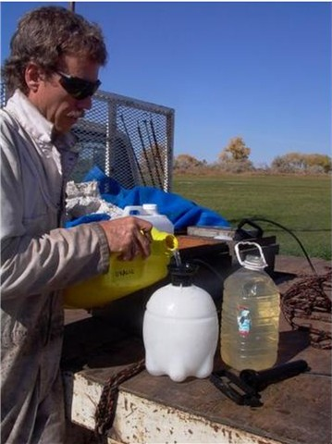
Protect your eyes
Notes:
There is always splashing—even though the solution is similar to lemon juice, you don’t want to get it into your eyes!

Slide 23

Tastes like strong lemonade
Notes:
Wash off any spilled or spashed oxalic solution from your skin with water. After washing, taste your skin. If it tastes like lemonade, there is still acid present. I taste my hands regularly to make sure that there are not traces on my skin.

Slide 24
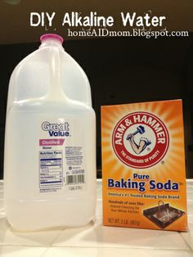
Carry baking soda in water to neutralize
Notes:
We carry a jug of water with some baking soda in it, just in case we somehow spill the solution on our clothes. Baking soda will instantly neutralize the acid.

Slide 25
Application

Slide 26
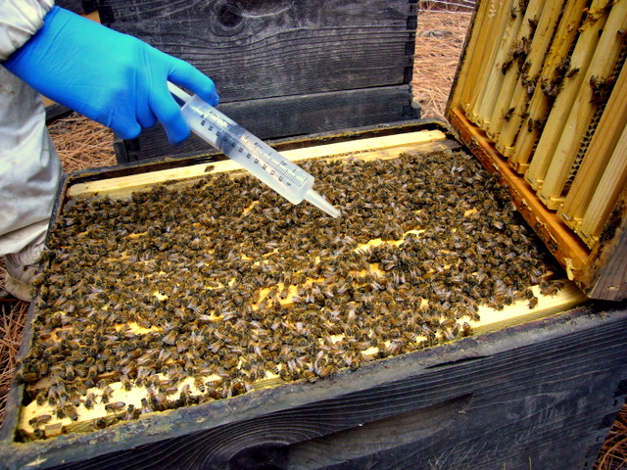
Must be applied directly to bees’ bodies.
Notes:
Solution that falls on the top bars may not be touched by the bees.

Slide 27
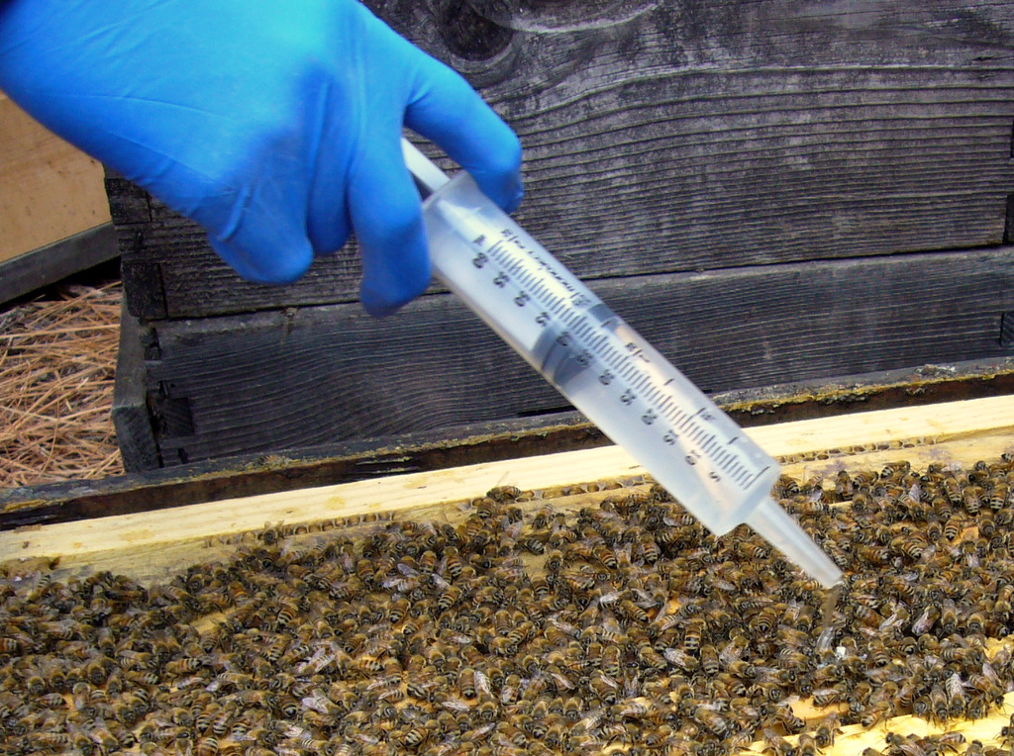
~5 mL per “seam” of bees
Notes:
The Europeans recommend not applying more than 50 mL in total to a colony in fall. Here in California (with a short broodless period), we apply 5 mL per seam, even if there are more than 10 seams of bees. I see no negative effect, but there may be one where winters are colder and longer.

Slide 28
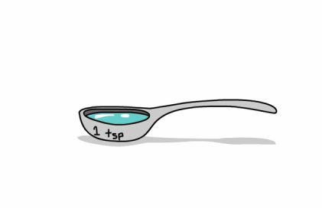
1 tsp = 5 mL

Slide 29
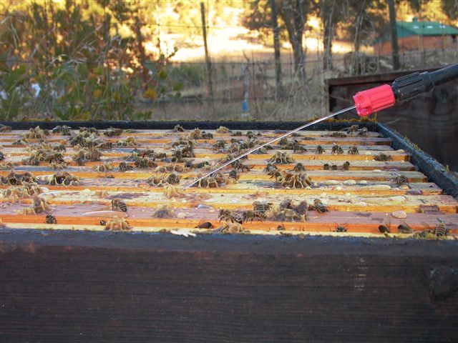
Dribble, not spray
Notes:
You don’t want a spray, as that would create a fog of oxalic that you might breathe. (The droplets on the top bars are because it took 4 takes to get this photo).

Slide 30
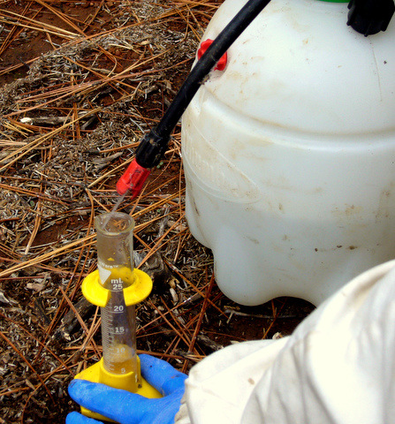
Calibrate pump output
Notes:
Use a graduated cylinder or measuring cup graded in milliliters to adjust the stream to 5 mL per second. Then count one second per seam of bees. I simply hold the trigger on as I move the wand up and down the seams for the entire hive—it takes 10 seconds to dribble a full box of bees.

Slide 31
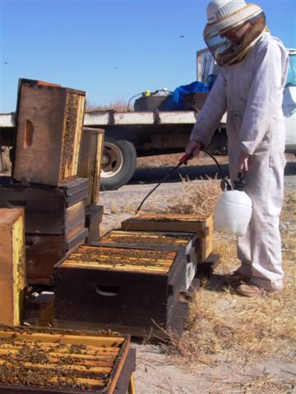
Hit both boxes
Notes:
Here’s my wife Stephanie applying dribble. Nowadays we generally use two of us—one tipping the upper box back, while the other one works the sprayer. If the cluster is split evenly between the boxes, we tip the upper box back and squirt it from below. If the cluster is mainly in the upper box, we take off the lid and dribble it from the top.

Slide 32
Tips:
Fill the garden sprayer only about ¼ full of solution. This leaves a large air space, which minimizes the fluctuation in pressure.
After you’ve dribbled a yard of hives, measure how much syrup you’ve applied in total, and divide by the number of hives. This will tell you if you’re applying the correct amount.

Slide 33
Timing of Treatment

Slide 34
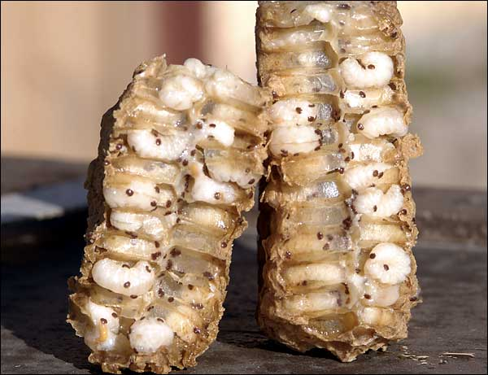
Oxalic won’t kill mites in the brood.

Slide 35
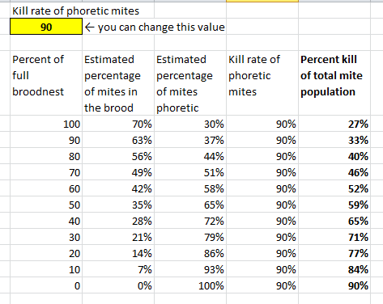
Note the difference in efficacy, dependent upon how much brood is present.
Oxalic gives poor efficacy if there is much brood present,
especially if drone brood is present.

Slide 36
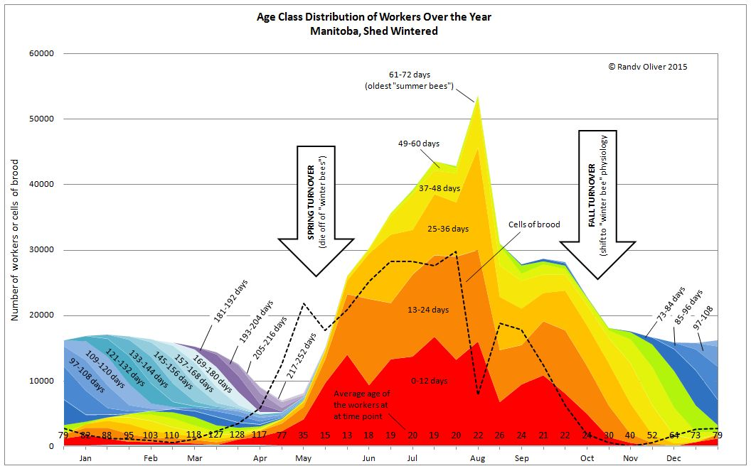
Seasonality Best treatment windowsof Worker Demographics
Notes:
Take advantage of treatment windows when there is little brood.

Slide 37
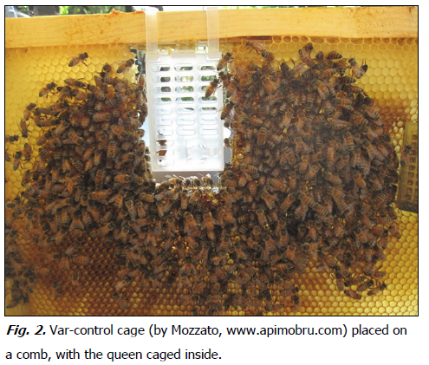
Beekeepers in Italy create an induced brood break
during late summer by temporarily caging the queen
Notes:
Cage the queen for 2 weeks, then release her. Apply oxalic dribble at 4-5 days after her release.

Slide 38
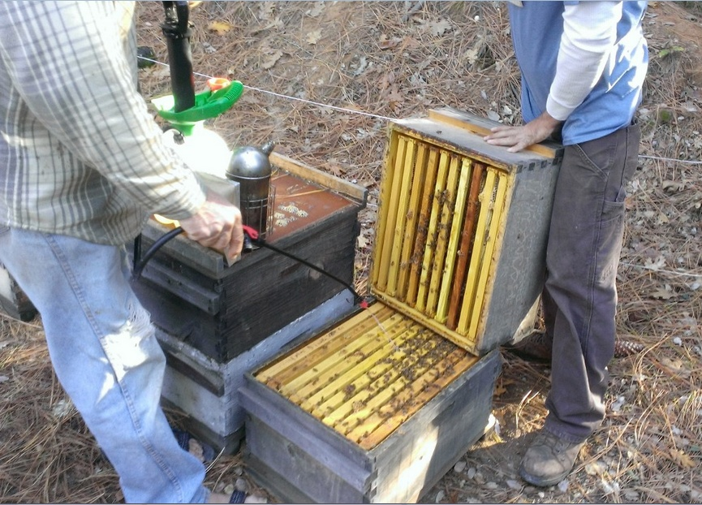
Fall treatment
Oxalic acid is, by far, most effective when colonies are broodless.

Slide 39
Use against nosema

Slide 40
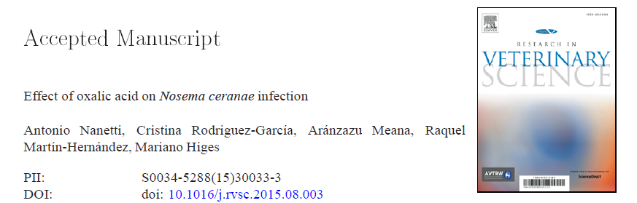

Slide 41
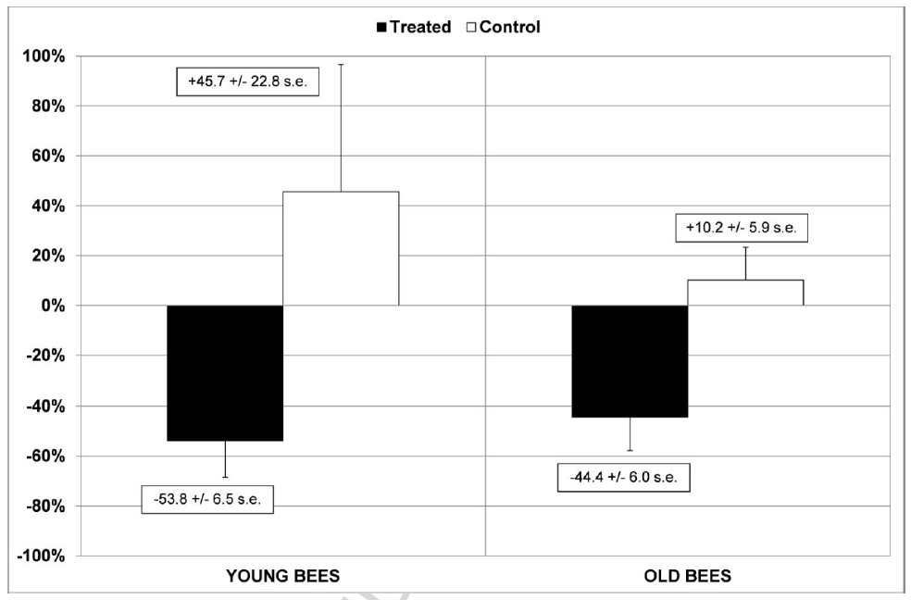
Nosema infection after fall dribble of weak OA, 50mL/hive
Notes:
Oxalic dribble may have benefit against nosema. Oxalic causes bees to shed their gut lining cells, perhaps flushing out nosema.

Slide 42
Summer Treatment
Can be used on severely mite-stressed colonies to buy time.
Must be repeated at weekly intervals.

Slide 43
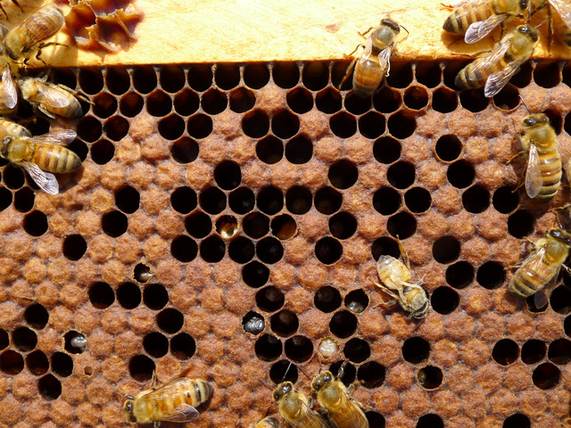
Colony about to collapse

Slide 44
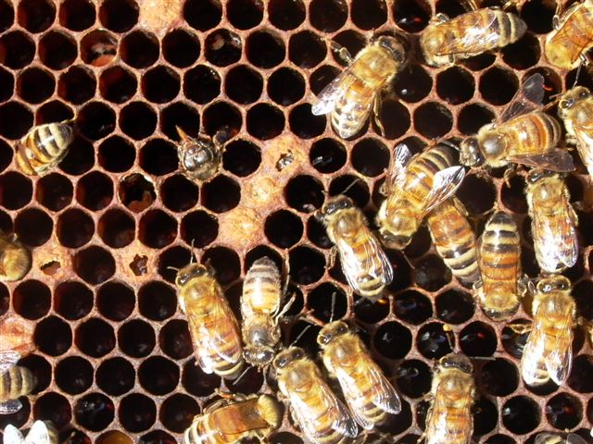
Formic or thymol may be too strong a treatment

Slide 45
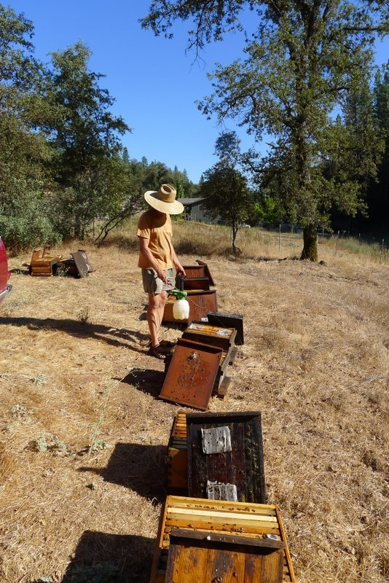
Summer treatment 3x weekly.
Around 50% mite reduction.

Slide 46
Treatment of Nucs or Packages
A no brainer

Slide 47
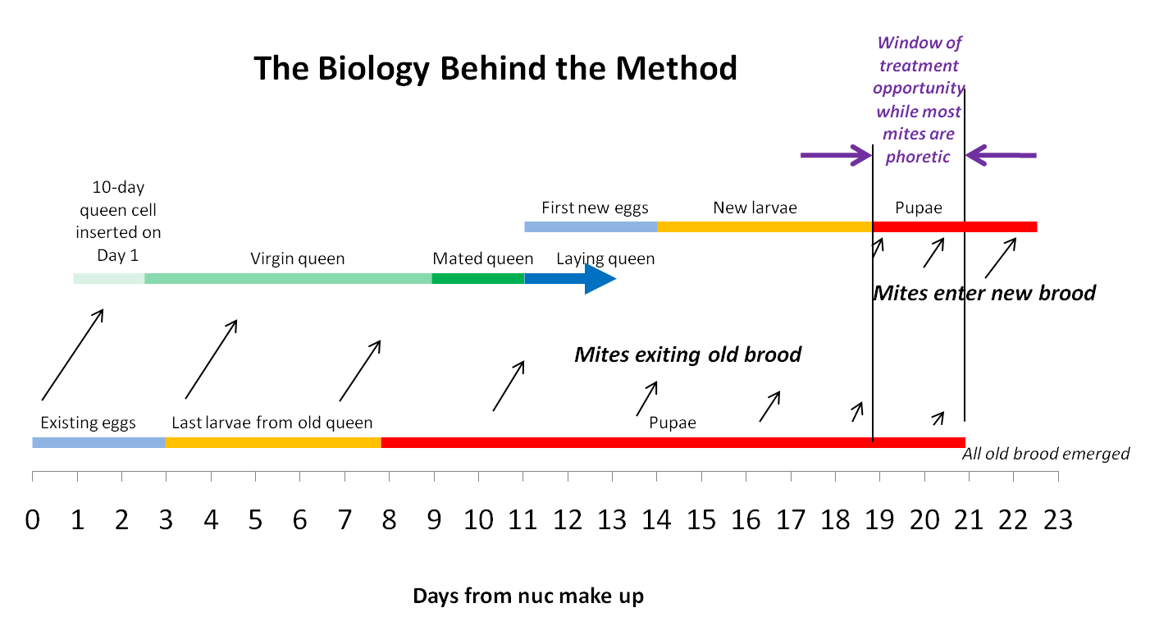
Treatment window for nucs
Notes:
See: http://scientificbeekeeping.com/simple-early-treatment-of-nucs-against-varroa/

Slide 48
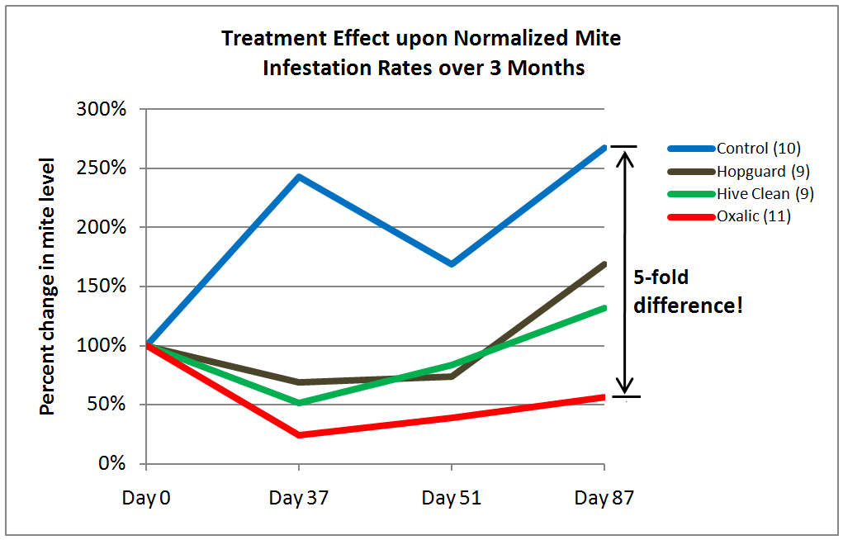
Notes:
Oxalic treatment of nucs greatly reduces the mite level, and give the colonies a “clean start.” It takes 5 seconds and costs about a nickle.

Slide 49
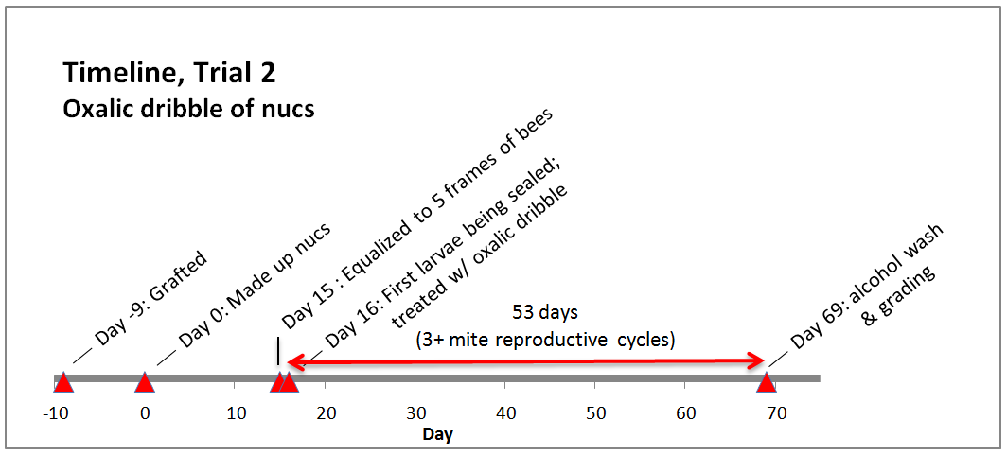
Notes:
A second experiment to see whether it affected colony growth: http://scientificbeekeeping.com/does-oxalic-acid-treatment-of-nucs-affect-honey-production/

Slide 50
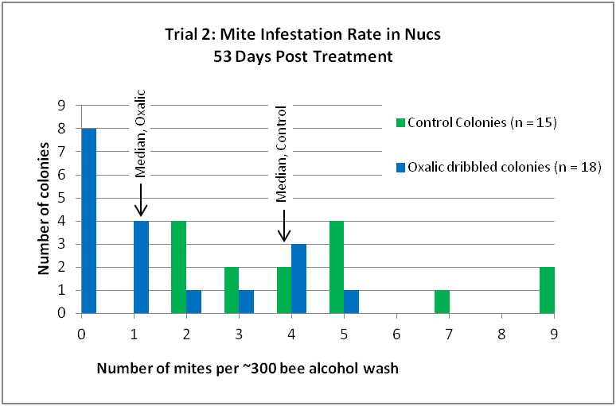
Notes:
Mite levels were greatly reduced

Slide 51
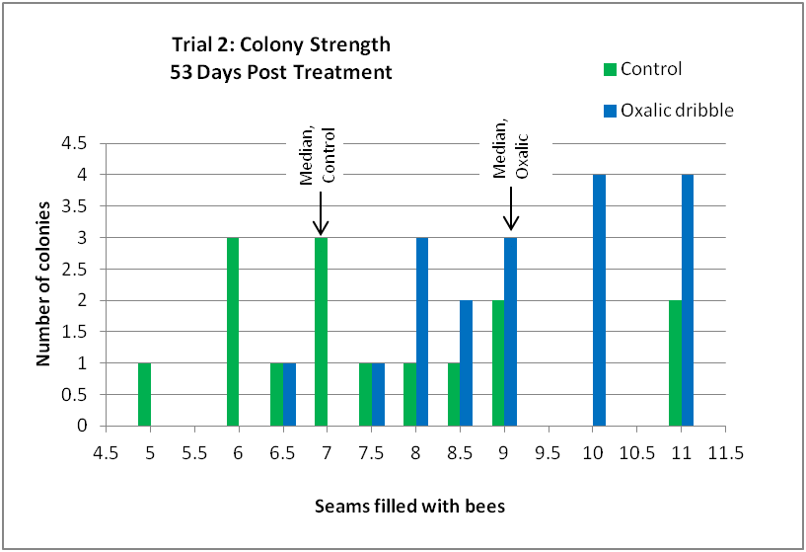
Notes:
The oxalic-treated nucs grew substantially more rapidly!

Slide 52
Create a spreadsheet to keep track of dates

Slide 53
Induced Brood Break

Slide 54
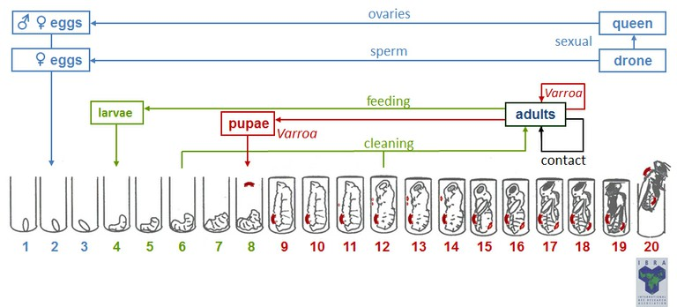
Understand the timing!

Slide 55
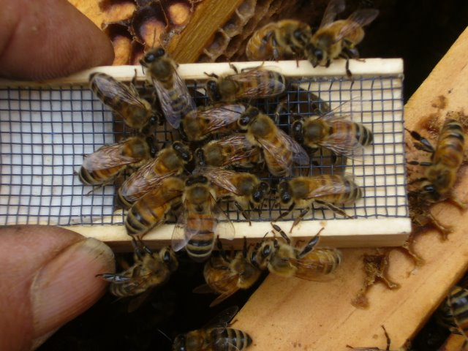
Cage the queen for 12 days minimum. Then release her. Treat 4-5 days later.
Notes:
Once the queen resumes egglaying, no mites can enter a cell for 8 days. Treatment at 4 to 5 days after queen release results in optimal exposure of the mites to oxalic.

Slide 56
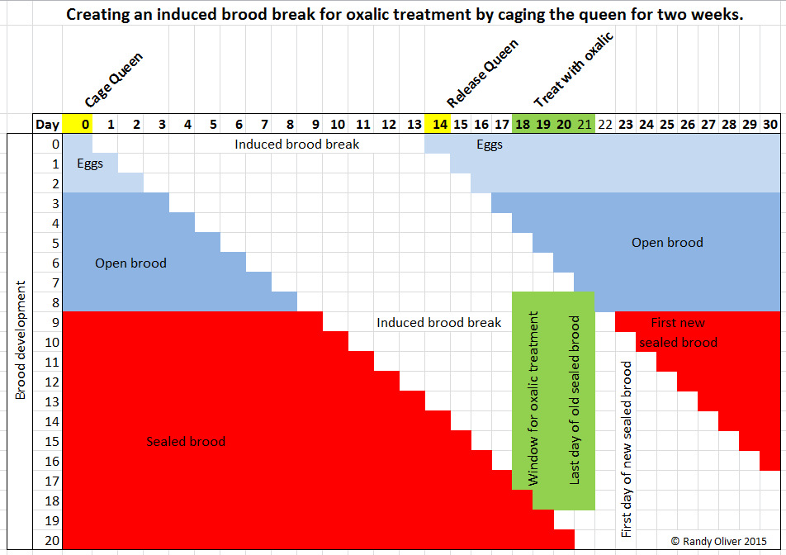
Notes:
Note the timing for the green window for oxalic treatment when all mites will be exposed to the oxalic.

Slide 57
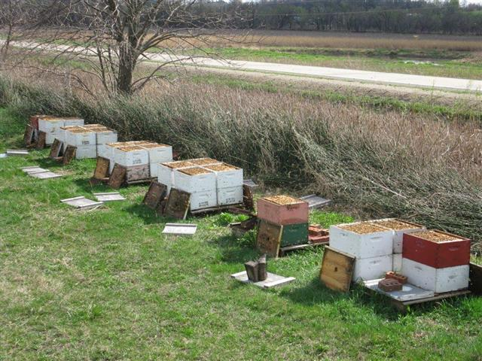
http://eberthoney.com/
Treat walkaway splits at 20 days.

Slide 58
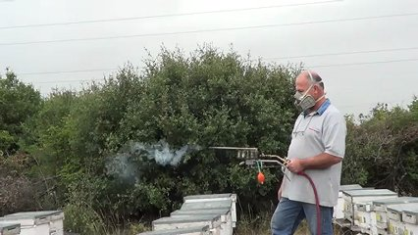
Vaporization
(Sublimation)
Notes:
Lots of beekeepers are excited about oxalic vaporization, since they don’t need to open their hives to treat. I’m not so enthusiastic, due to operator safety concerns, and the buildup of oxalic acid residues in the hive.

Slide 59
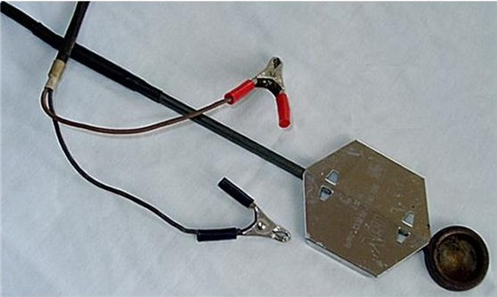
Useful where winter comes on suddenly.
Notes:
This is an inexpensive device. Others that incorporate accurate temperature control and a blower work better.

Slide 60
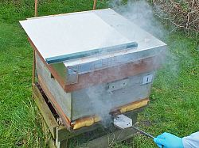
Simple Varrox vaporizer.

Slide 61
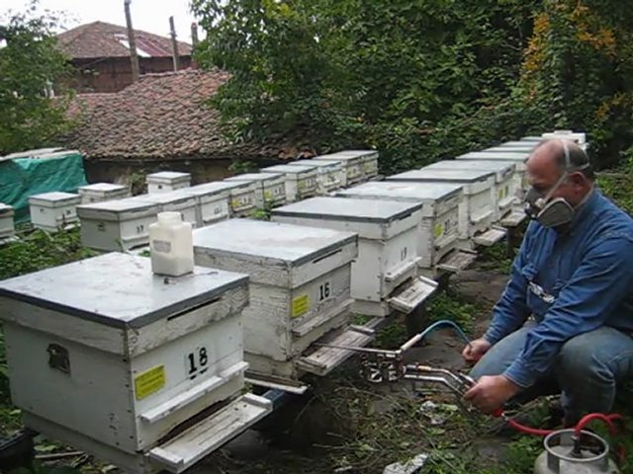
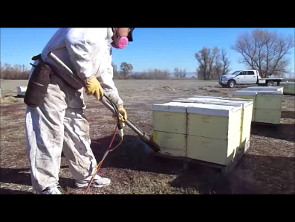
Vaporized oxalic is dangerous!
Wear a respirator.

Slide 62
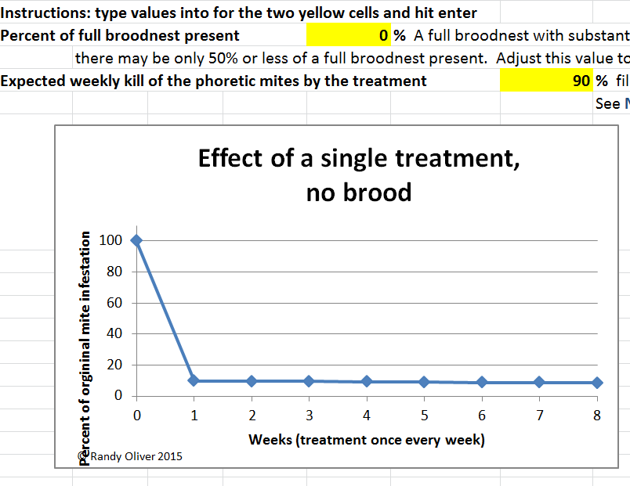
Notes:
Good efficacy if there is no brood present, and the vapor penetrates the cluster.

Slide 63
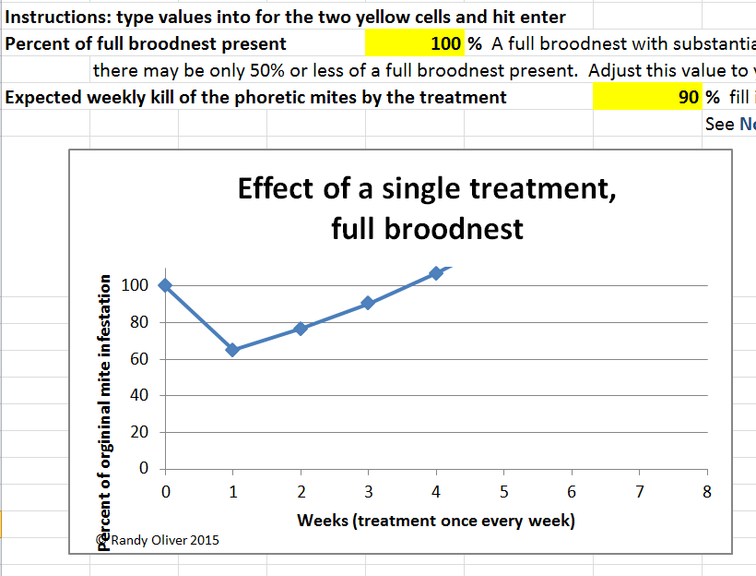
Notes:
Little benefit if applied when the colony is in full brood production.

Slide 64
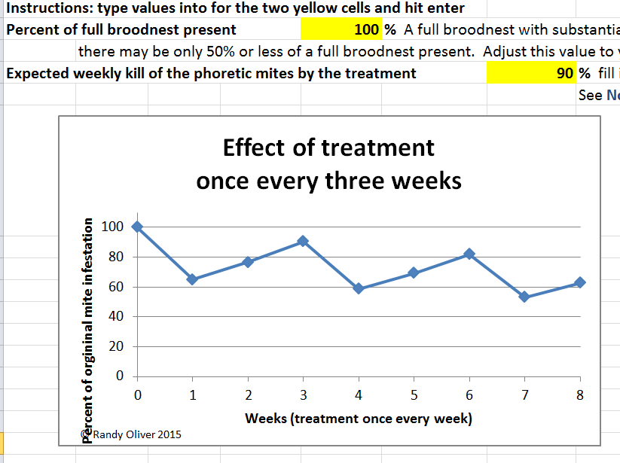
Notes:
Even with multiple treatments during the summer, efficacy may be low.

Slide 65
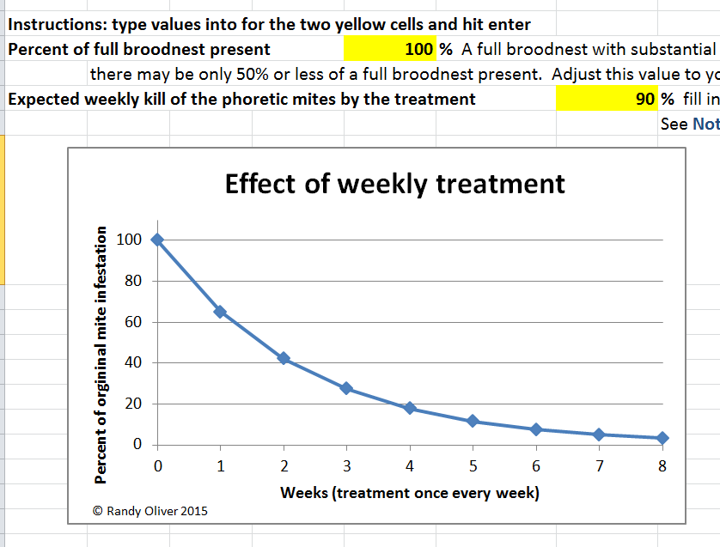
Notes:
This is an example of the efficacy of weekly oxalic treatments. This many treatments would be stressful to the colony.

Slide 66
Another application method

Slide 67
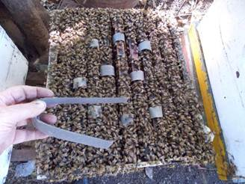
Oxalic/glycerine formulation.
Notes:
This method is being tested in Argentina and Chile. I plan to test it soon.

Slide 68
A Critical Closing Thought
“The only way to halt the development of resistance to a certain product is by interrupting its use in the control strategy.”
Lodesani (2009) Limits of chemotherapy in beekeeping: development of resistance and the problem of residues.
Notes:
VARROA MANAGEMENT CONCEPT #1:
It’s not about knocking mite levels down—
the trick is to never allow them to get high in the first place!

Slide 69
Practice some sort of rotation of treatments
Amitraz
Thymol
Oxalic
Formic

Slide 70
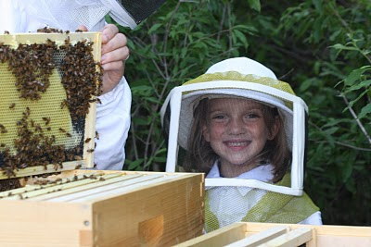
Bloom Honey Co
Bloom Honey Co
Happy beekeeping!
ScientificBeekeeping.com

