Slide 1
Varroa Destructor
and the hobbyist beekeeper
Tate Belden (tate@millenhaus.com) http://ncbees.org

Slide 2
Varroa Destructor
“World’s most devastating pest of Western Honey bees.”
Originated with Apis Cerana, Asian honey bees. First detected in US in 1987
Three strategies that consistently fail:
Denial: “I haven’t seen any mites, so my mite levels must be low.”
Wishful thinking: “I haven’t seen very many mites, so I’m hoping and praying that my bees will be OK.”
Blind faith: “I used the latest snake oil mite cure, and it’s gotta work!”

Slide 3
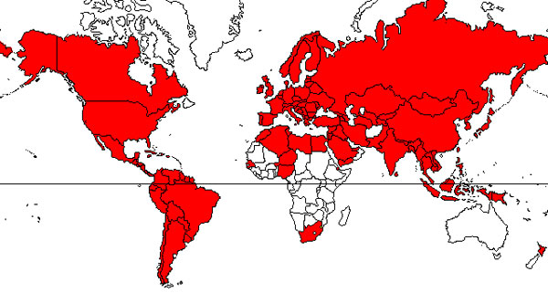
Range of Infestation
Varroa mite distribution - 2010

Slide 4
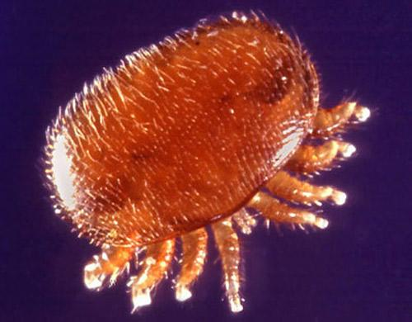
Adult Female

Slide 5
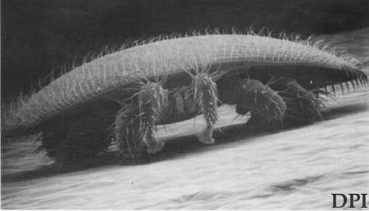
Side View - Adult Female
Notes:
Note curvature of the body - shield effect.

Slide 6
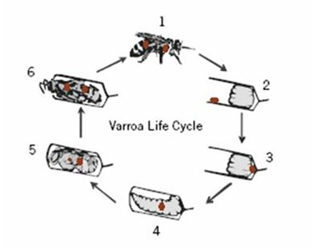
Life Cycle
1 - Adult female enters hive
2 - Finds uncapped larvae
3 - Hides under larvae
4 - Lays male egg
5 - Mating
6 - Male eggs laid
7 - Feed on larvae
8 - Mature and emerge with
adult bee

Slide 7
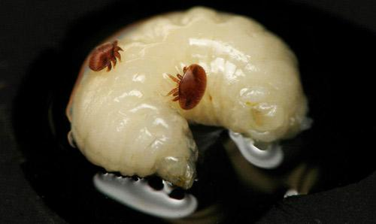
Adult females on larvae

Slide 8
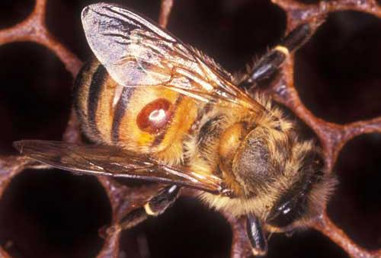
Phoretic mite

Slide 9
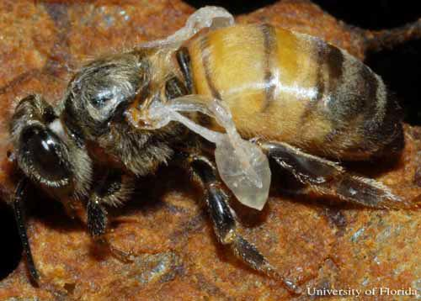
Deformed Wing Virus (DWV)

Slide 10
Is there any hope?
Pretty doom and gloom. May as well pack up and sell newspapers….
BUT NO! There’s more!
Just because we can not eliminate Varroa, doesn’t mean we can’t control them.
Idea is to keep infestation down to a manageable level, where bees survive and are not harmed by too high of a mite count.

Slide 11
Control of mite population
No hive in North America is immune to Varroa destructor.
You will have mites. Not “if”, but “when”.
Question is - what do you do about ‘em?
Mitigating factors:
Genetics
Colony Strength
Treatments

Slide 12
Genetics
So called ‘Hygienic’ strains of bees have behaviors that either tolerate or control mite populations. (VSH, Russian, Minnesota Hygienic, etc)
Government efforts - breeding programs to develop resistant breeds.
Large scale producers - tend to hold on to what they have for economic advantage.
Private, small scale beekeepers - not as effective, but very willing to share. Over time may be our best hope.
Desired behaviors are affected by location and environment.

Slide 13
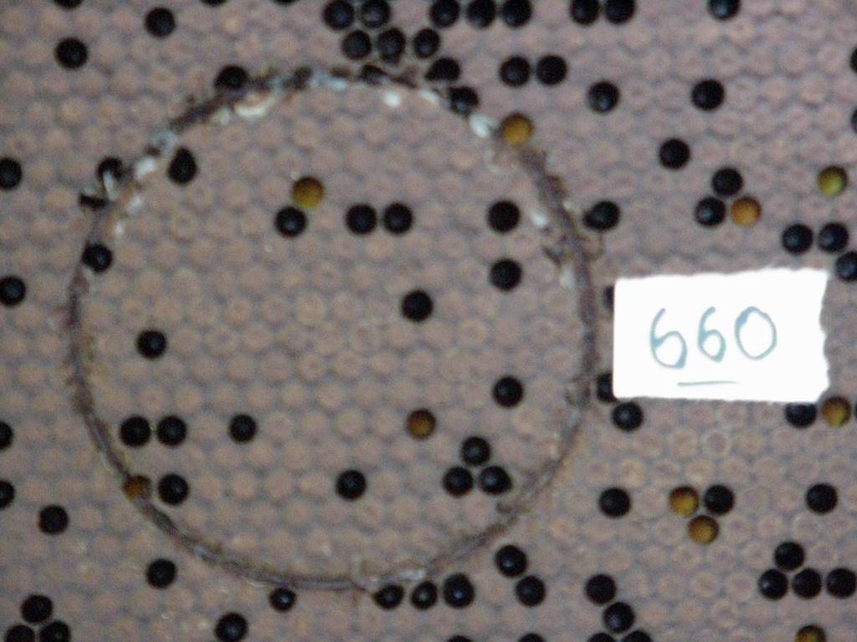
Hygienic behaviors
Nope, not a poorly laying queen, but rather hygienic behavior.
Infected cells are opened and larvae discarded.
Circle is used to count number of cells pulled.

Slide 14
Strong Colonies
As with any pest, disease or other problem. Strong, healthy colonies seem to be able to stand up under multiple stressors - until they break and collapse.
Colonies weakened by any disease, pest or agent are that much more susceptible to other insults.
Consider combining weaker colonies - special if mid to late summer and they appear to be struggling.
Treat first! So as to not spread a problem around.

Slide 15
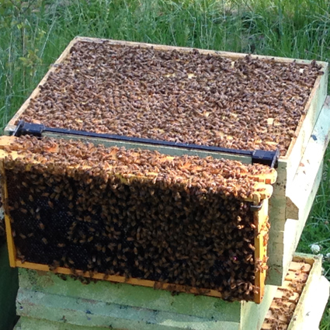
A strong colony

Slide 16
How bad is your mite load?
You need to know mite population in order to know if mitigating actions are working or need to be applied. Stay on top of this! You can have a mite population explosion and a colony devastated with in one brood cycle
Sticky boards (drop counts)
Rolls - Sugar, alcohol or ether
Brood sample - capping fork

Slide 17
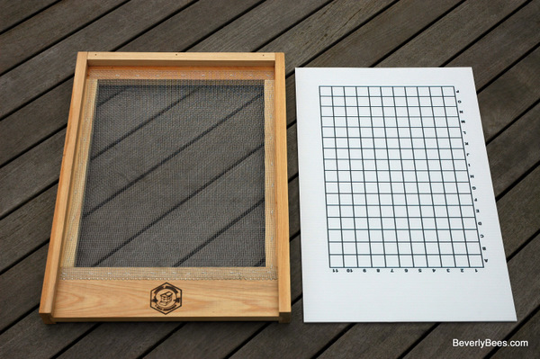
Sticky Boards
A commercially available screened bottom board - with a sticky board.

Slide 18
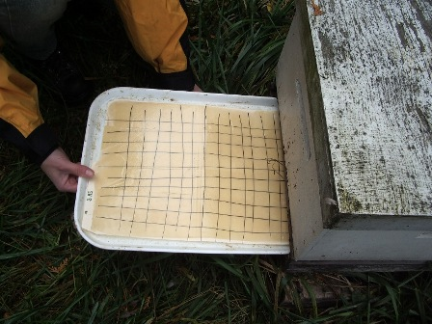
Homemade sticky board
Don’t need to be fancy. DIY boards work just as well.
Count all grid squares.

Slide 19
How to count with a sticky board
24 hours sticky board under screen
Multiply number of mites found by 250 to 500 when broodless or 20 to 40 when brood is present.
Don’t need to know “exact” numbers. Just if there are too many.
If you count 50 mites in a 24 hour drop - stop. You know you have a problem.
Sticky boards can be wildly inaccurate if used at beginning or ending of brood rearing. During brood season they are the best method of estimating mite load.

Slide 20
How to count with a jar
Sugar, alcohol or ether roll.
Collect aprox 300 nurse bees from brood area (about 1/2 cup).
Apply agent
Filter and count

Slide 21
Collect your sample
Glass, wide mouthed jar - lid of choice determined by agent used.
Sealed or screened lid.
Don’t try to scoop!
Brush edge of jar down the frame allowing bees to fall into jar.
Only takes 2 or 3 swipes on a frame to collect an adequate sample.

Slide 22
Ether roll
Agent used is automotive starter fluid.
FIRE DANGER - if you have anything lit nearby, don’t spray starter fluid!
Closed jar with sample inside. Only collects %50 to %70 of mites.
Fast and easy to use for large yards.
Take many samples - average them out - provides a working yard estimate.
Possible some bees may recover from this harsh treatment.

Slide 23
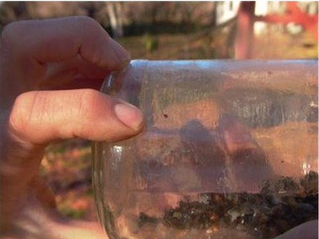
Ether Roll
Bees spit up nectar/honey
Coats jar
Ether causes mite fall
They stick to the nectar/honey
Count mites on the jar

Slide 24
Alcohol Wash
Add approx 2 to 3 cups of rubbing alcohol (70% or higher) to the sample jar.
Agitate, shake and ensure all are thoroughly soaked, wash mites off bees.
Pour liquid off through filter (coffee filters work well).
Repeat, 2 washes gives a more accurate count than just one.
Count mites - count the bees. Divide mite number by bee number. If over 5%, treat. If over 10%, colony may already be lost.
Kills the sample, but is very accurate count.

Slide 25
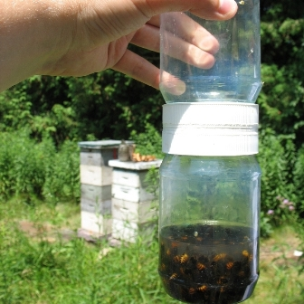
A specialty Jar
“Double lid”
Easier to use

Slide 26
Sugar Roll
If you’re concerned about killing your queen, use a sugar roll. Non destructive.
Sample - jar must have a screened lid.
Add a few tablespoons of confectioners sugar.
Agitate - Repeat - let sit for one minute.
Invert jar and shake sugar and mites out onto a light colored surface.
Mist sugar with water to dissolve.
Count mites.
Release bees from jar (they’ll be very unlikely to sting if you’ve done it right)
accurate from 65 to 90%.

Slide 27
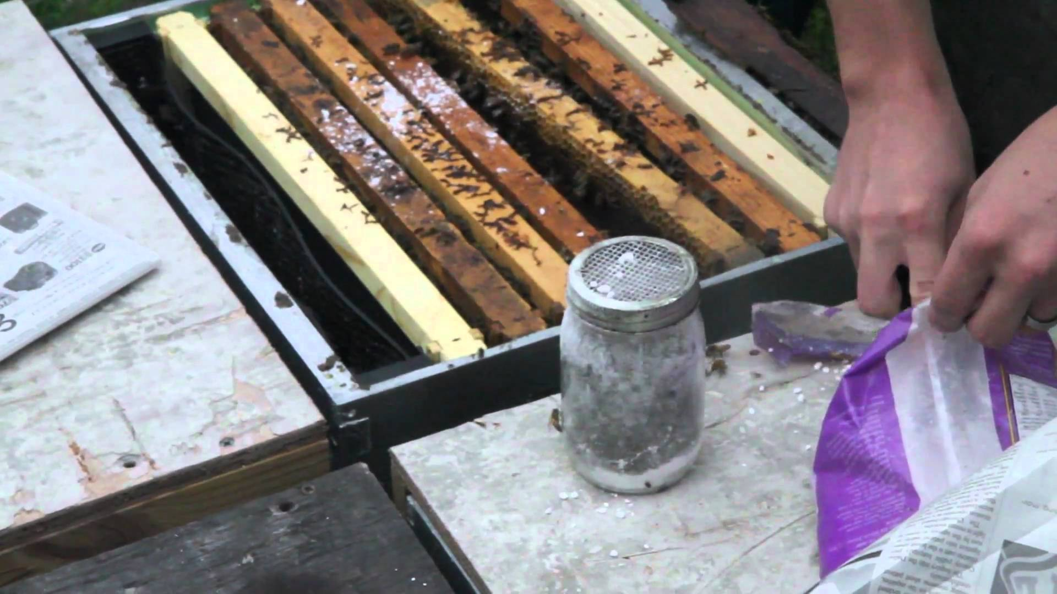
Sugar Roll

Slide 28
Brood Sampling
Varroa prefer drone to worker brood by about 10 to 1. Basis for brood frames used in IPM (but that’s for another discussion).
Open a few cells, look for ‘pink eyed’ drones.
Using an uncapping fork or hair pick, skewer 20 drones through thorax and pull them out of their cells.
Tap frame out over light colored surface.
Very unreliable! Must inspect at least 100 cells - more is better.
Not a recommended method, unless you like eating brood (it’s considered a delicacy in some cultures).

Slide 29
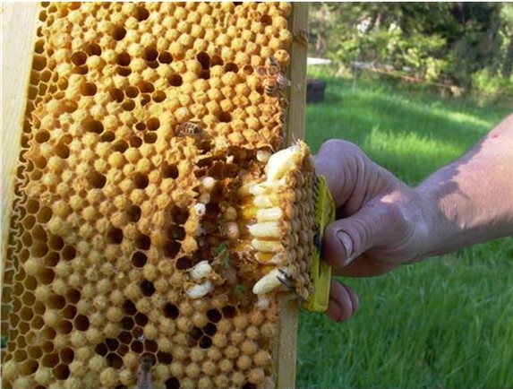
Brood Sampling

Slide 30
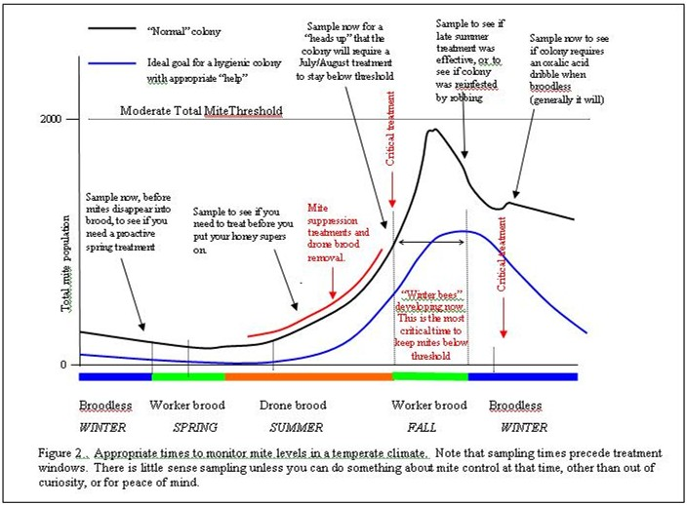
When to use what method
During broodless winter, all mites are ‘phoretic’ - outside a cell.
July is critical time to count.
Watch for DWV!

Slide 31
What’s my threshold?
Two strategies:
Manage mites
Take action during mite buildup and anytime you see high counts.
2) “Peak and Treat”
Allow mites to buildup to ‘injury threshold’ and treat aggressively.
If at any time your colonies show evidence of viruses, tracheal mite, or nosema, your acceptable threshold levels must be greatly reduced.

Slide 32
OK, I know I have a problem
Now what?
Only one answer, treat them. But with what?
That’s up to you - just remember, sugar dusting is not a treatment. It may contribute to helping to keep counts below problem levels as part of an IPM plan, but if you have a problem, sugar dusting won’t help your bees.
Treatments include, but are not limited to:
MAQS (Formic Acid) CheckMite+ (coumaphos)
HopGuard (??) Oxalic Acid (dribble or vapor)
ApiLifeVar (Thymol +) Apiguard (Thymol)
Apistan (Fluvalinate, a pyrethroid) Apivar (Amitraz)

Slide 33
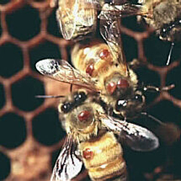
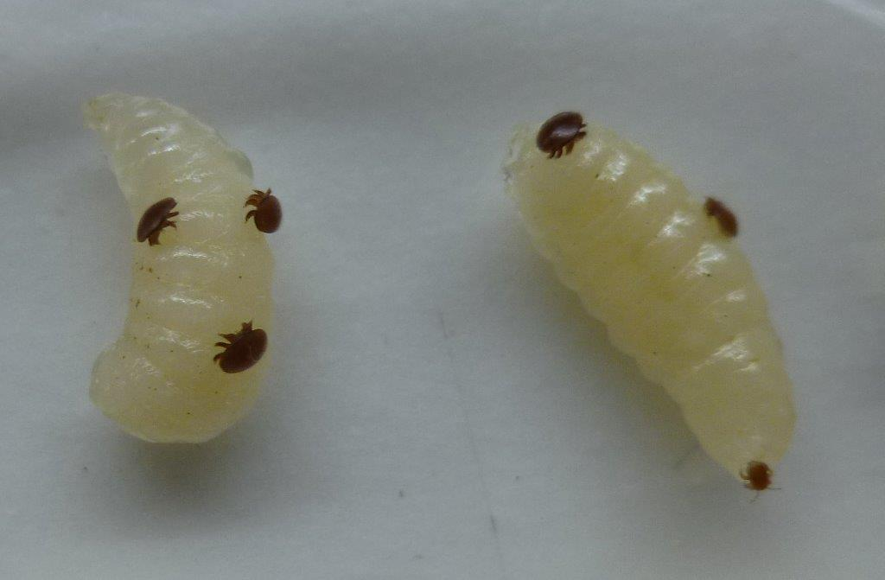
Help them

Slide 34
What you do is up to you
These are your bees - it’s up to you.
Just remember, you do have an affect on everyone else.
Suspected that mites move from colony to colony on drones, as drones are readily accepted in any colony. Mites prefer drones, so…
If you have a high mite load, your strong colony may be able to tolerate them, but you will spread mites around, compounding the problem and creating a reservoir for future infestation.

Slide 35
Video on how to do jar counts
https://youtu.be/dU06KJTxHR8?t=82
Published on Aug 24, 2014
Dr Dewey Caron is joining me today to demonstrate how to do 2 other methods for counting mites: an alcohol wash, and a sugar roll.

Slide 36
Sources
http://scientificbeekeeping.com/fighting-varroa-reconnaissance-mite-sampling/
http://entnemdept.ufl.edu/creatures/misc/bees/varroa_mite.htm

